Slide 1
Digital Portfolio
STUDENT NAME : POOJA C
REGISTER NO AND NMID : 33A10C88CD2053D8B814246629631461
DEPARTMENT : COMPUTER SCIENCE
COLLEGE/UNIVERSITY : JEPPIAAR COLLEGE OF ARTS & SCIENCE,
MADRAS UNIVERSITY

Slide 2
PROJECT TITLE
Digital Portfolio Website Using Front-End Web Development

Slide 3


AGENDA
Problem Statement
Project Overview
End Users
Tools and Technologies
Portfolio design and Layout
Features and Functionality
Results and Screenshots
Conclusion
Github Link
3/21/2024 Annual Review

Slide 4

PROBLEM STATEMENT
Students lack a structured platform to showcase skills, projects, and achievements.
Traditional resumes cannot fully demonstrate creativity and technical skills.
Need for a digital, interactive portfolio to improve visibility to recruiters.

Slide 5

PROJECT OVERVIEW
A personal portfolio website designed using HTML, CSS, and JavaScript.
Contains sections like Home, About, Skills, Work, and Contact.
Fully responsive, user-friendly, and easy to navigate.
Highlights academic background, skills, and project work.

Slide 6

WHO ARE THE END USERS?
Students: To present their achievements and projects.
Recruiters: To evaluate technical and creative skills.
Faculty: To assess student progress.
Companies: To identify potential interns and employees.

Slide 7

TOOLS AND TECHNIQUES
HTML5, CSS3, JavaScript – for front-end design.
Responsive Web Design principles.
VS Code – development environment.
GitHub – code management and hosting.
Boxicons & UI Libraries – for icons and design.

Slide 8
POTFOLIO DESIGN AND LAYOUT
Home: Self-introduction and role.
About: Personal background and goals.
Skills: Technical expertise with percentages.
Work: Project gallery with images.
Contact: Form and social media links.
Design Style: Clean, minimal, modern, responsive.
8

Slide 9
FEATURES AND FUNCTIONALITY
Responsive design (mobile, tablet, desktop).
Interactive navigation menu.
Skills section with progress bars.
Project gallery with image previews.
Contact form for easy communication.
Social media integration (LinkedIn, GitHub).
Smooth scrolling and animations.

Slide 10
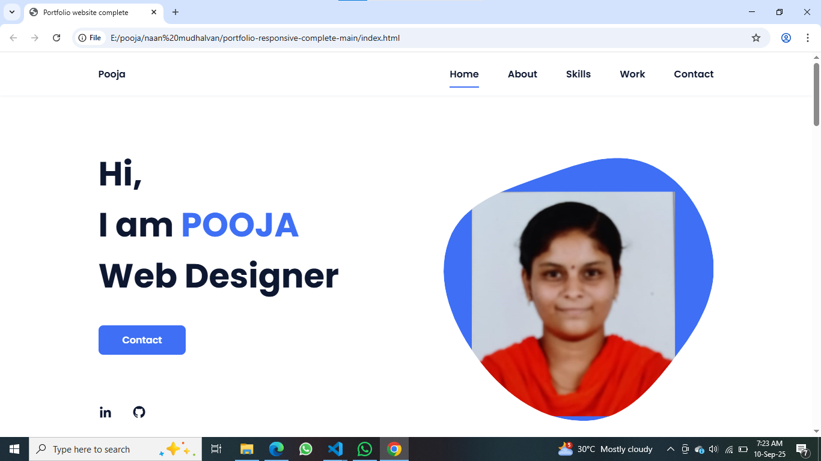

RESULTS AND SCREENSHOTS
3/21/2024 Annual Review
10

Slide 11
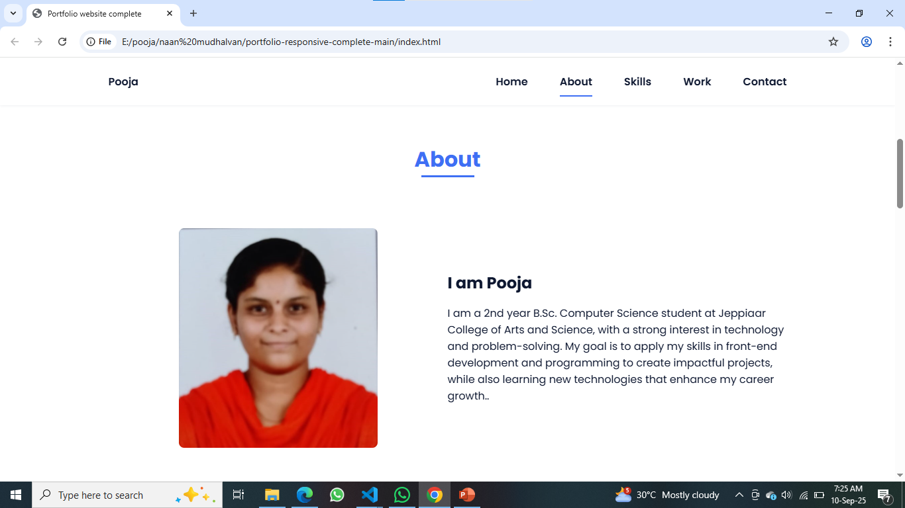

Slide 12
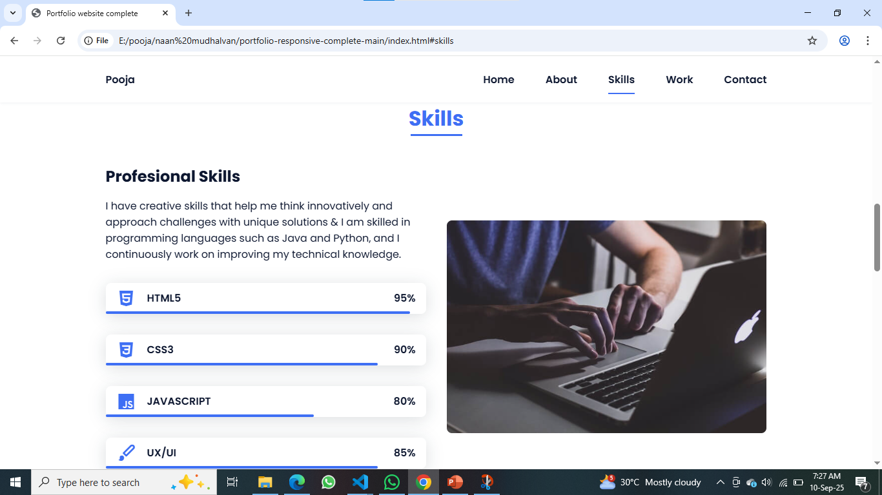

Slide 13
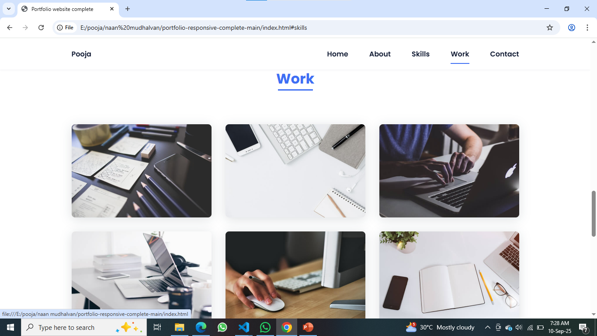

Slide 14
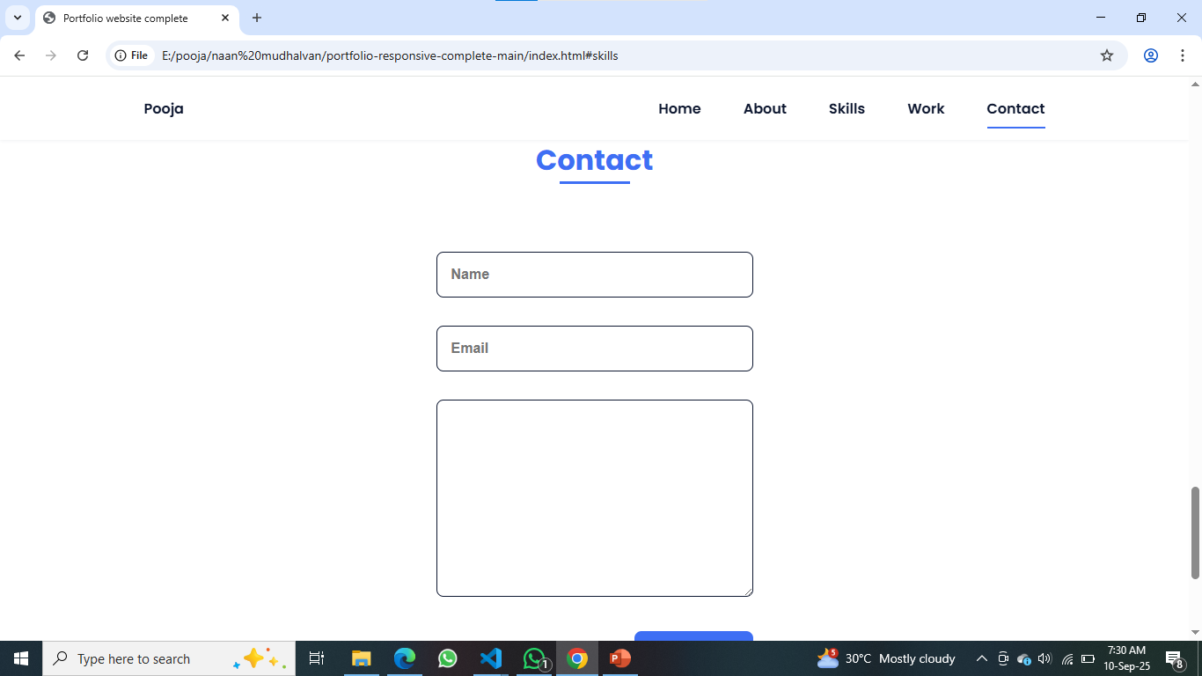

Slide 15
CONCLUSION
A digital portfolio is a modern and effective way to showcase talents.
Enhances career opportunities by professionally presenting skills.
Acts as an online resume and project gallery.
Future Scope: Adding blogs, certifications, and live project links.
15

